Slide 1
How digital and AI technology is transforming public sector internal audit Iain McGregor Director of Innovation and Development Government Internal Audit Agency

Slide 2
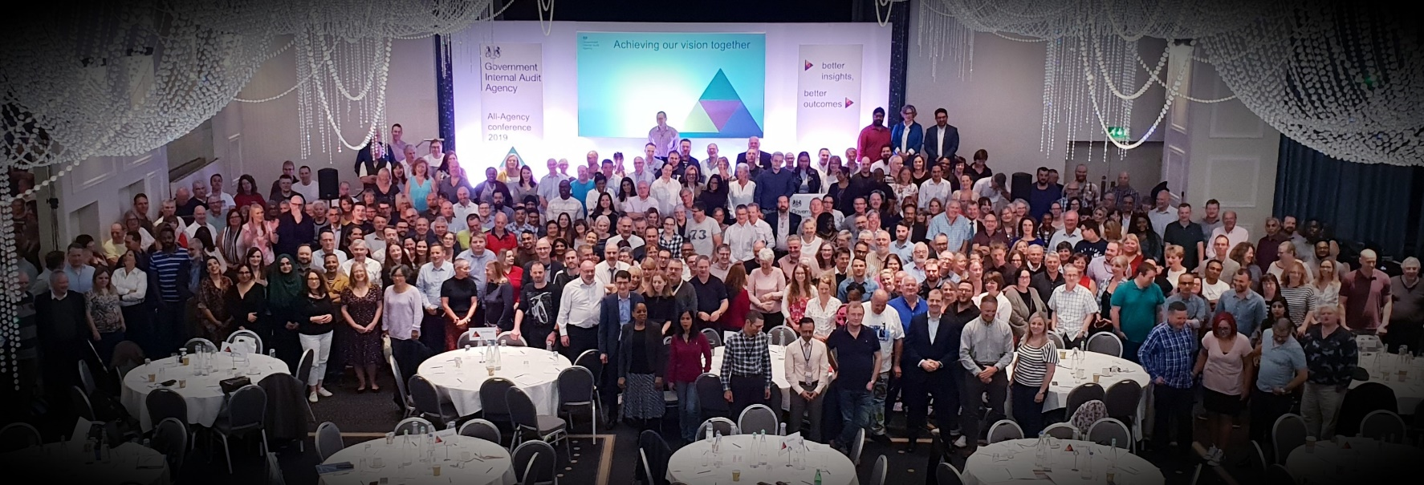
Government Internal Audit Agency
Internal audit and Counter Fraud and Investigation
450 Staff
13 Central Government Departments
130 Government Organisations
Notes:
Breadth and depth
Insights generation
Depth from data

Slide 3
Innovation
Wider agency
Community of Practice
GIAA Innovation Hub
Experiment
Learn from failure
Succeed
Core Team
Data Analytics

Slide 4
Example of Data Analytics
Anonymised demonstration data used

Slide 5
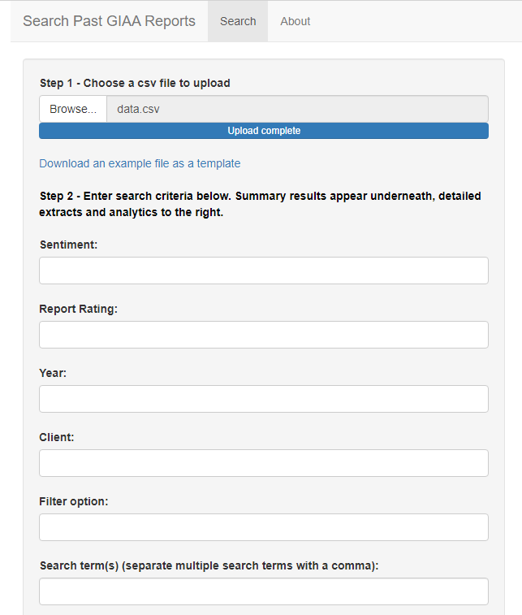
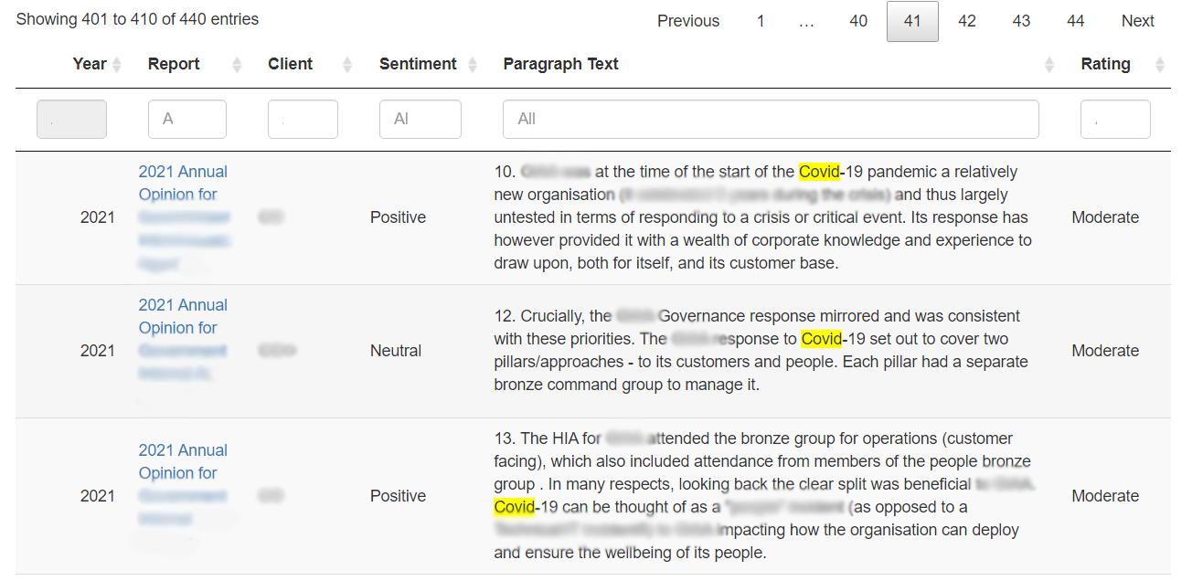
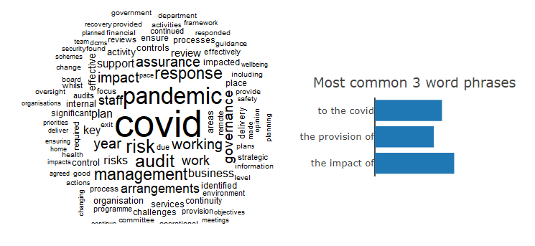
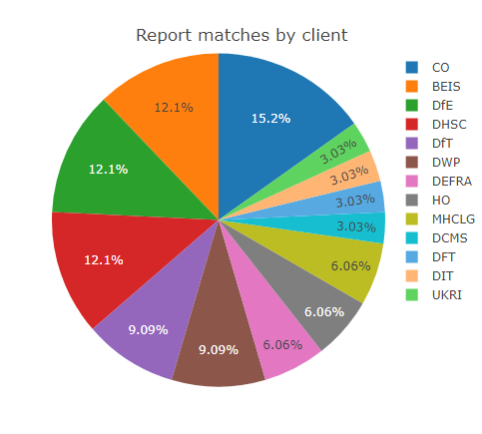
GIAA Insights Engine
People at the centre
Advanced search
Data visualisation
NLP
Common phrases
Sentiment Analysis
102 Annual Opinions
Original search tool developed by NAO

Slide 6
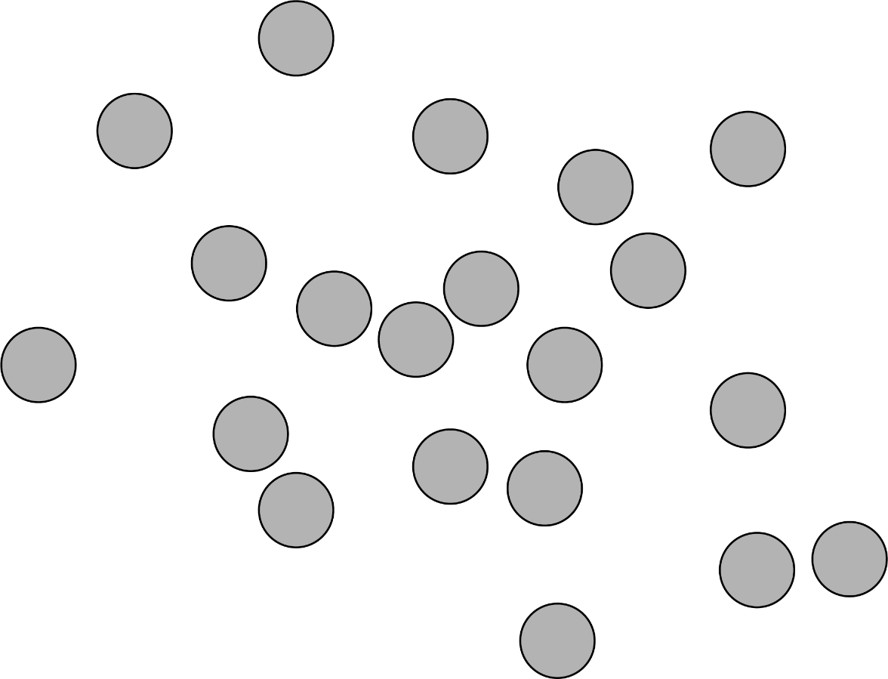
Learn from other sectors
20 documents from GOV.UK website
7 on Knowledge Assets
13 on innovation
Ref: Textnets package, C Bail, Duke University

Slide 7
Final Thoughts
Put people at the centre of what you do
Choice of technology
How you do it
Innovate
Learn from other sectors
Be ambitious
Learn from Failure

Slide 8
Iain McGregor correspondence@giaa.gov.uk linkedin.com/in/iainjmcgregor

